Slide 1
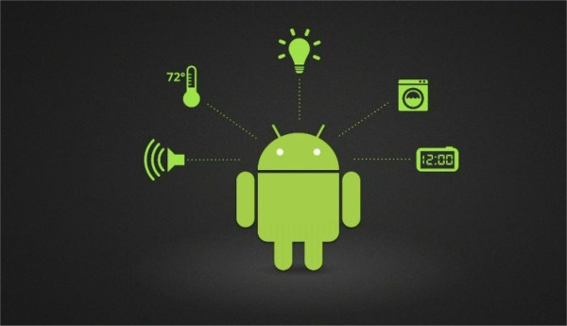
Android – Robot Arm control App
STUDENTS : EDGAR ACOSTA
ABBAS ALSHAFAI

Slide 2
Android – Robot Arm control App
WITH THIS PROJECT WE IMPLEMENTED THE FOLLOWING:
- ANDROID GRAPHICAL USER INTERFACE
- SQ LITE DATA BASE
- THREADS
- ACTIVITIES AND INTENTS
- BLUETOOTH COMMUNICATIONS WITH ANDROID
- ANDROID – ARDUINO COMMUNICATION
- EMBEDDED C PROGRAMMING IN ARDUINO
- AND ELECTRONICS

Slide 3
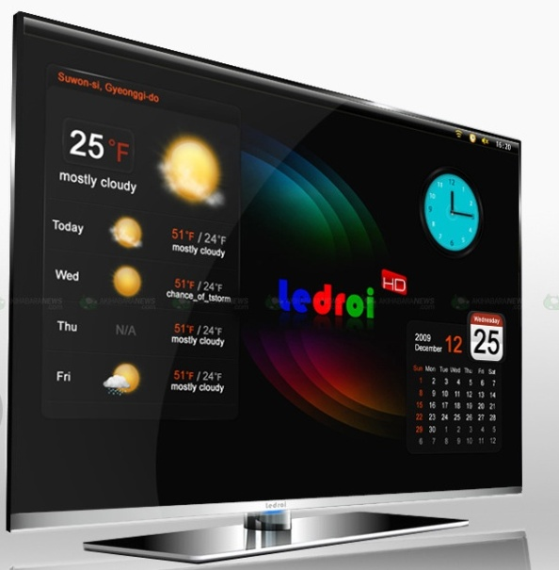
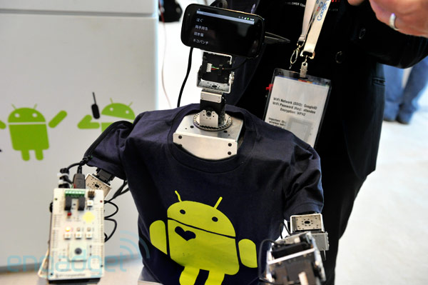
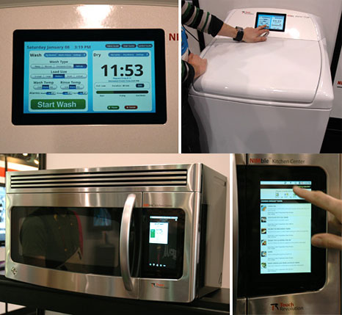
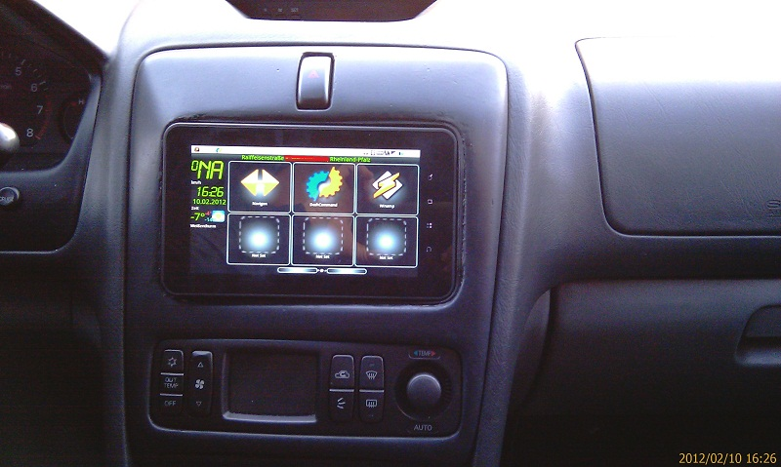
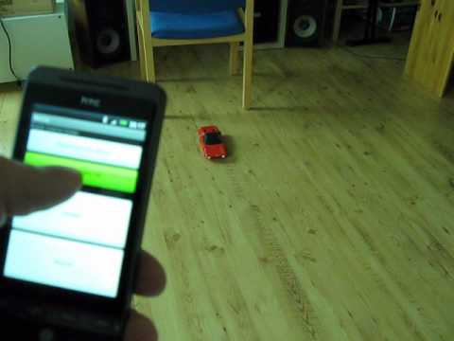
Many companies have seen Android as a potential operating system for home appliances/gadgets/automotive control, industry control…
ANDROID TV
DELPHI AUTOMOTIVE SYSTEMS INTEGRATE A TABLET IN VEHICLE

Slide 4
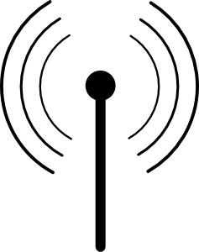
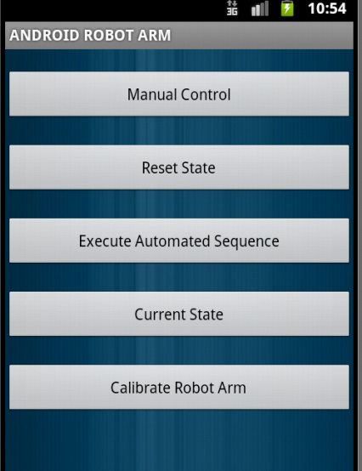
Robot Arm -Android Application
Manual Control to move manually every part of robot arm
Reset State Sequence
Automated Sequence
Robot Current State Browser
Repositioning and Calibration of Robot Arm
Main Activity

Slide 5
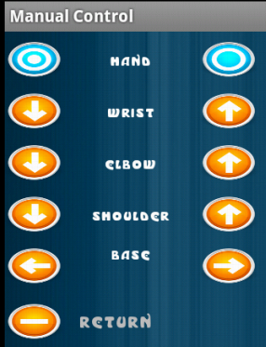
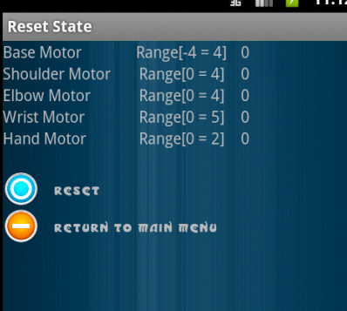
Robot Arm -Android Application
Manual Control
Reset State Sequence

Slide 6
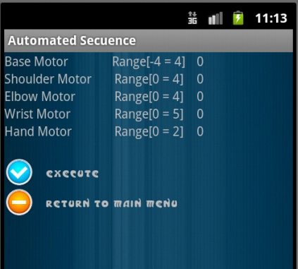
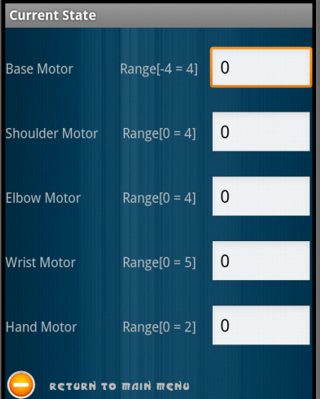
Robot Arm -Android Application
RESET STATE SEQUENCE
CURRENT STATE MONITOR

Slide 7
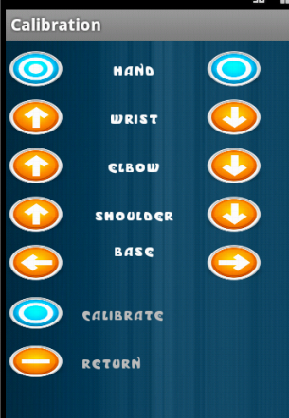
Robot Arm -Android Application
REPOSITIONING AND CALIBRATION

Slide 8
Android – Robot Arm control App
THANK YOU…

